Slide 1

Predicting the Future with Azure Machine Learning
Notes:
Machine Learning – often a key concept when talking about advanced analytics and intelligence, lets deep dive into what machine learning is, where it is being used today and how Microsoft is enabling democratisation of machine learning
So some examples
Bing predicts the Premier League football scores on a weekly basis given statistics from the past performances, environmental data etc. As well as various political elections and award shows like the oscars
Thyseen Krupp a lift company in the US are trying to predict when lifts will break down. Are they able to look at the sensor readings, the service data, the parts, make and model and try and predict or pre-empt when a lift will break down
An example I often use as a demo, can we predict if a flight will be delayed or not given the flight and weather details
All these predictions involve some form, some complex some simple, of machine learning algorithm. So lets take a look at machine learning

Slide 2



Transform data into intelligent action
Information Management
Big Data Stores
Machine Learning and Analytics
Intelligence
People
Data Sources
Data Factory
Data Lake Store
Machine Learning
Cognitive Services
Data Catalog
SQL Data
Warehouse
Data Lake Analytics
Bot Framework
Web
Apps
HDInsight
(Hadoop and Spark)
Mobile
Event Hubs
Cortana
Apps
Bots
Sensors and devices
Stream Analytics
Dashboards & Visualizations
Automated Systems
Power BI
Data
Intelligence
Action
Notes:
T: Cortana Intelligence provides everything you need to transform your organization’s data into intelligent action. Next, let’s take a look at another demo.

Slide 3
Data at Scale
Information Management
Big Data Stores
Machine Learning and Analytics
Intelligence
Data Factory
Data Lake Store
manages
SQL Data
Warehouse
Data Lake Analytics
OR
Data Sources
HDInsight
(Hadoop and Spark)
Dashboards & Visualizations
Notes:
T: Cortana Intelligence provides everything you need to transform your organization’s data into intelligent action. Next, let’s take a look at another demo.

Slide 4
Data at Speed
Information Management
Big Data Stores
Machine Learning and Analytics
Intelligence
Data Lake Store
Machine Learning
SQL Data
Warehouse
Apps
Apps
Event Hubs
People
Stream Analytics
Dashboards & Visualizations
Sensors and devices
Power BI
Automated Systems
Notes:
T: Cortana Intelligence provides everything you need to transform your organization’s data into intelligent action. Next, let’s take a look at another demo.

Slide 5
Data at Speed with Apache Storm/Spark
Information Management
Big Data Stores
Machine Learning and Analytics
Intelligence
Data Lake Store
R
R Server
Apps
Apps
HDInsight
Storm/Spark
Event Hubs
Cortana
Dashboards & Visualizations
Sensors and devices
Power BI
Automated Systems
Notes:
T: Cortana Intelligence provides everything you need to transform your organization’s data into intelligent action. Next, let’s take a look at another demo.

Slide 6
Machine Learning
Information Management
Big Data Stores
Machine Learning and Analytics
Intelligence
Data Factory
Data Lake Store
Machine Learning
Cognitive Services
Re-training
SQL Data
Warehouse
Apps
Data Sources
Event Hubs
Dashboards & Visualizations
Power BI
People
Notes:
T: Cortana Intelligence provides everything you need to transform your organization’s data into intelligent action. Next, let’s take a look at another demo.

Slide 7
Traditional BI
Information Management
Big Data Stores
Machine Learning and Analytics
Intelligence
Data Factory
manages
People
SQL Data
Warehouse
Data Sources
Cortana
Dashboards & Visualizations
Power BI
Notes:
T: Cortana Intelligence provides everything you need to transform your organization’s data into intelligent action. Next, let’s take a look at another demo.

Slide 8
Conversation as a Service
Information Management
Big Data Stores
Machine Learning and Analytics
Intelligence
Machine Learning
Cognitive Services
Bot Framework
Apps
Event Hubs
Dashboards & Visualizations
Conversation
Intelligence
Notes:
T: Cortana Intelligence provides everything you need to transform your organization’s data into intelligent action. Next, let’s take a look at another demo.

Slide 9
Computing Systems that become smarter with Experience Experience = Past Data + Human Input
Notes:
This. Microsoft is enabling the democratisation of machine learning by creating tools and pre-built solutions .
So I want to talk to you about machine learning like this
Where machine learning is computer systems that become smarter with experience
This is the only equation we will see today – past data + human input
Where past data is growing on a daily basis, we have data coming from …
And where often the human input describes the type of machine learning used
Given past data can we try to predict what might happen in the future

Slide 10
Classification
Regression
Supervised
Agent Based Learning
Unsupervised
Anomaly Detection
Reinforcement Learning
Clustering
https://azure.microsoft.com/en-us/documentation/articles/machine-learning-algorithm-choice/

Slide 11

http://blogs.technet.com/b/machinelearning/archive/2015/11/03/using-azure-ml-to-build-clickthrough-prediction-models.aspx
Notes:
Click stream prediction models – showing the efficiency of Learning by Counts options for large sparse data sets.
Classification – two class, will the customer click the advert or not (1 or 0)

Slide 12

Notes:
Anomaly Detection – credit card fraud, being able to spot that anomaly point in your data, being able to alert in real time if something doesn’t look quite right

Slide 13

Notes:
Clustering – customer/audience segmentation

Slide 14

https://customers.microsoft.com/Pages/CustomerStory.aspx?recid=19460
Notes:
Recommendation engines and the ability to build into Azure ML

Slide 15




Why Now?
Notes:
So why now?
In the past many algorithms quite old, however had to be simplified to actually be usable, now this is no longer a problem and complex algorithms can be used. This is because of 3 factors
One, we can use the power of the cloud and borrow the compute power and storage from there
Agility/ease of use – rapidly prototyping, Being able to train these models in a shorter amount of time
And the easily available data to sufficiently train these models. Connected devices
This has allowed for machine learning to be operationalized and available to everyone to produce intelligent applications

Slide 16
What is Azure Machine Learning
Data
Clients
API
ML STUDIO
Model is now a web service that is callable
Blobs and Tables
Hadoop (HDInsight)
Relational DB (Azure SQL DB)
Integrated development environment for Machine Learning
Monetize the API through our marketplace
Notes:
The elegance of the solution is in its simplicity – something that has been lacking in the machine learning space
The first issue many enterprises face is data ingestion. With the cloud, you can bring in data sources with the ease of a drop down or drop your on-premises data set into the built in storage space. Users can then model in our development environment – Machine Learning Studio
where we’re offering R, Python and SQLite as first class citizens in addition to our world-class Microsoft algorithms.
The second issue – and often the primary one – is putting finished work into production in a way others can use. Client devices, websites, mobile applications, excel spreadsheets you name it anything that supports HTTP requests.
We’ve heard from many data scientists that they model in R on a Linux stack but then have to hand over their work to developers who need to translate that into another language to actually make it work.
This time consuming and unnecessary process has been eliminated with our system, as the model is with a click transformed into a web service end-point that can run over any data, anywhere and connect to any solution or client.
Next, not only can this model be put into production for your company, it can be made available for the world on our Machine Learning Marketplace. Microsoft hosts your solution and markets it for you, while you have the freedom to brand and monetize as you see fit.

Slide 17
Machine Learning Process Model
Idea
Business Knowledge
Data Understanding
Data
Data Preparation
Retraining
Modelling
Evaluation
Publish
Notes:
Data and analytics can often get into the questions around algorithms and types of data - but ideas like this come from the domain knowledge and questioning initially
Always ask -how can we do this better, is there a better way.
This process is adapted from the Cross Industry Standard Process for Data Mining (CRISP-DM)

Slide 18
Azure Machine Learning Studio https://studio.azureml.net/

Slide 19
Flight Delay demo
https://gallery.cortanaintelligence.com/Experiment/Flight-Delay-Student-Lab-1

Slide 20
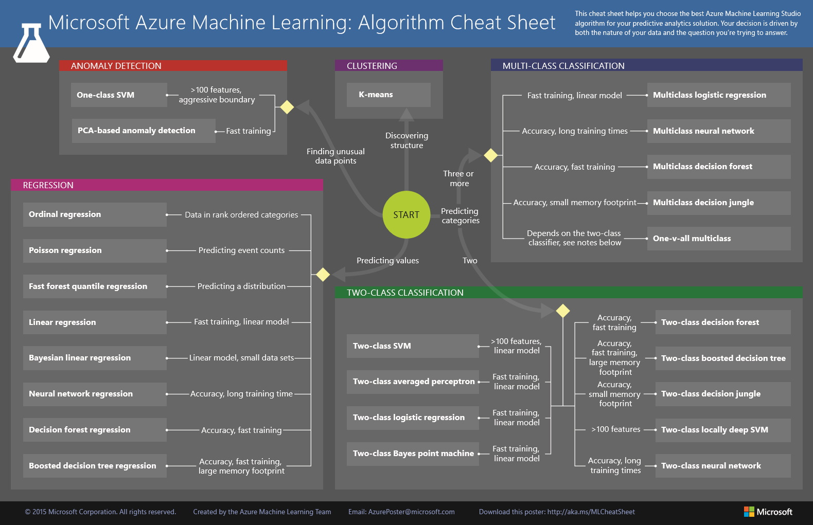
Notes:
https://azure.microsoft.com/en-us/documentation/articles/machine-learning-algorithm-cheat-sheet/

Slide 21
Machine Learning Gallery http://gallery.cortanaintelligence.com

Slide 22
Key Takeaways
Check out the Machine Learning blog for details on more of Azure ML’s features and stories: http://blogs.technet.com/b/machinelearning/
Investigate other Analytics Services and the Cortana Intelligence http://www.microsoft.com/en-us/server-cloud/cortana-analytics-suite/Overview.aspx
Start building your machine learning solutions: https://github.com/amykatenicho/AzureMachineLearningResources.git

